Slide 1
Storage Ring Working Group report
Review most recent progress with low emittance ring design and optimisation
toward diffraction limited sources – ultimate storage rings
on upcoming rings
possibility of improving the performance of existing rings
Identify outstanding problems and required R&D.
(joint session with the ID WG)
Investigate differences and synergies with ERL X-ray sources.
(joint session with the ERL WG)
Investigate progress and issues with lattice for short bunches and advanced THZ sources.

Slide 2
Storage Ring Working Group sessions
Session 1: 9 talks
low emittance ring design and performance (chair J. Safranek)
Session 3: 4 talks
USR design issues and R&D (chair M. Borland)
Session 6: 3 talks
New technology for USR and storage rings (chair G. Decker)
Session 5: 5 talks
Joint session with IDs (chair R. Bartolini)
21 talks
Session 4: 2 talks
Other light sources (chair R. Hettel)
Session 2: 2 talks
joint session SR – ERL (chair M. Borland)
Session 7: 3 talks
Low-alpha and THz emission (chair X. Huang)
tot. 28 talks

Slide 3
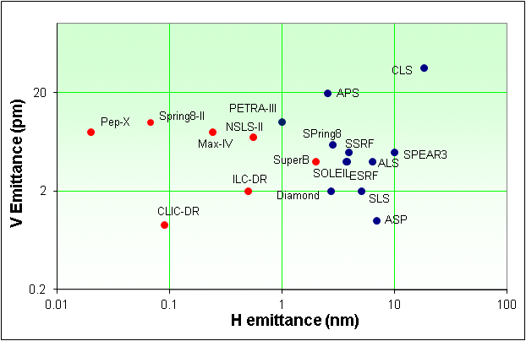
Low emittance and brightness
Tevatron ULS
3 pm
diffraction limited lattices
8 pm at 1 Angstron

Slide 4

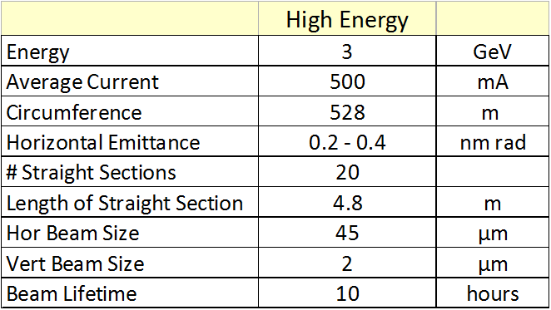
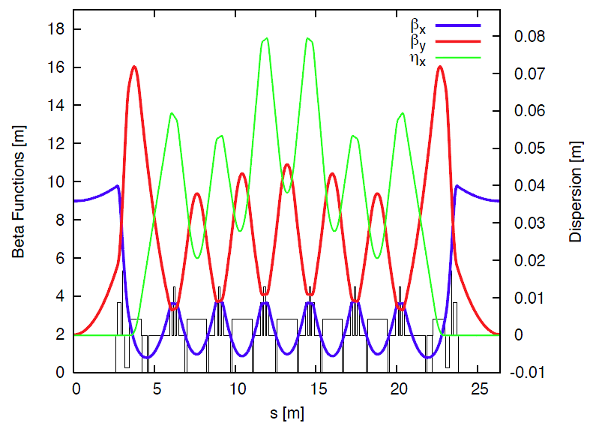
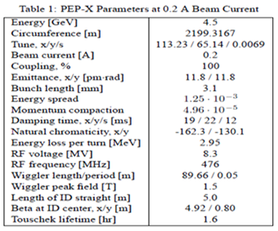
Multi-bend achromats (ε_{x} ~ 1/N_{D}³)
MAX-IV M. Sjostroem
Pep-X, Y. Cai, B. Hettel

Slide 5
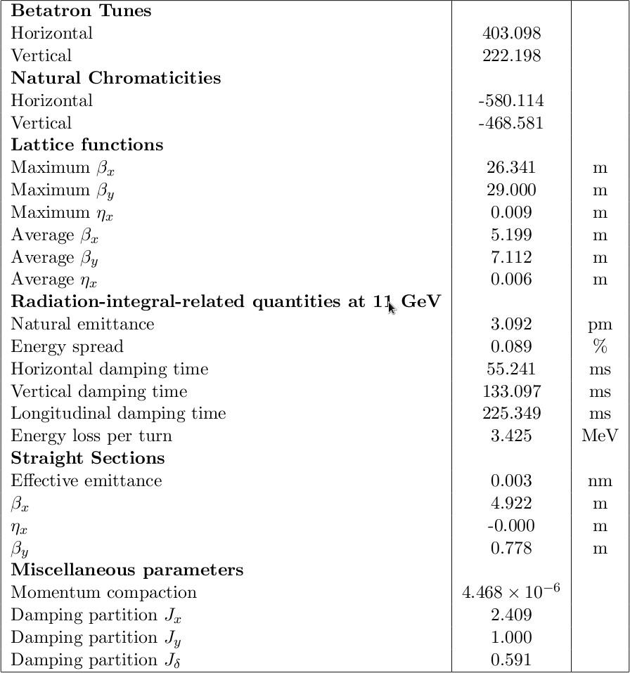
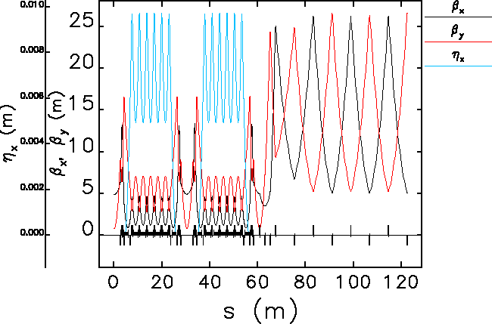
Multi-bend achromats (ε_{x} ~ 1/N_{D}³)
TevUSR M. Borland – 7BA lattice

Slide 6
Optimisation of low emittance lattices
Nonlinear beam dynamics : dynamic aperture and Touschek lifetime
MOGA – Multi-Objective Genetic Algorithms
Deterministic – Hamiltonian resonance driving terms
MOGA (multi-objectives multi-parameters)
LingYun (NSLS-II) dynamic aperture
M. Borland (APS) linar optics and dynamic aperture – Tevatron ULS
Deterministic approaches based on the analysis of resonance driving terms
Y. Cai for the Pep-X design team (plenary on Tuesday)
J. Bengtsson (NLS-II) DA for NLSL-II

Slide 7
MOGA with tracking
Objectives:
  Dynamic aperture
  Momentum aperture and lifetime
  Tune shift with amplitude, dn_{x,y}/dJ_{x,y}
  Tune diffusion
  Linear optics parameters
Variables: Sextupoles, Octupoles, Quadrupoles
Start form initial random population in the parameters space and generates new populations by crossover, mutations, and natural selection of best cases
Robust convergence with noisy function (DA)
Reveals trade-offs between multiple objectives
Easy for parallel computing
Direct tracking used to define the objectives of the optimisation
It can include magnet errors and misalignments

Slide 8
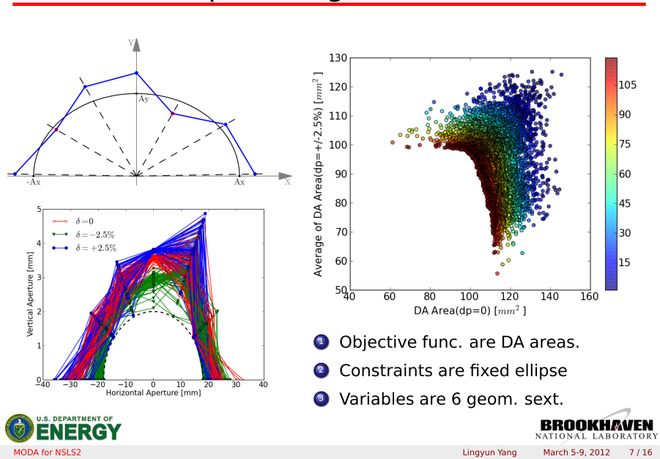
Optimizing NSLS-II DA & MA with MOGA (L. Yang)

Slide 9
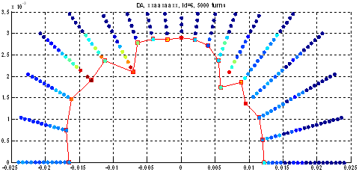
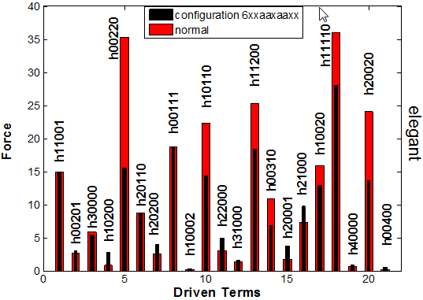
MOGA, 5000 turn tracking automatically corrects resonances in SPEAR (J. Safranek)
‘xxaaxaaxx’ power supply config.
MOGA SF/SD strengths
Resonance cancellation
Dynamic aper. restored
long straights
septum
y [mm]
5000 turn tracking
D.A. = 16 mm
x [mm]
March 6, 2012

Slide 10
Nonlinear resonance correction with Harmonic Sextupoles for Pep-X (Y. Cai)
For Tune Shifts and 2ν_{x}-2ν_{y}Resonance
Without harmonic sextupoles With harmonic sextupoles
OPA is used for optimizing the setting of 10 families of sextupoles. Due to the
cancellation of many resonances, the optimization becomes much simpler and easier.
OPA is an Accelerator Design Program from SLS PSI developed by A. Streun.

Slide 11
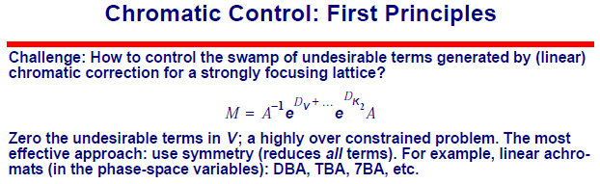
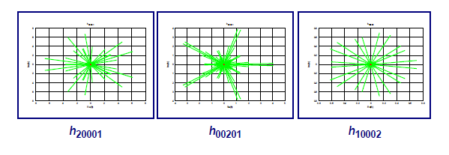
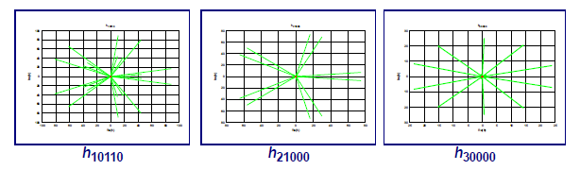
Analysis of resonance driving terms (J. Bengtsson)
Devise sextupole scheme that minimise driving term to first and higher order
Practical examples of resonance control at SLS and Diamond

Slide 12
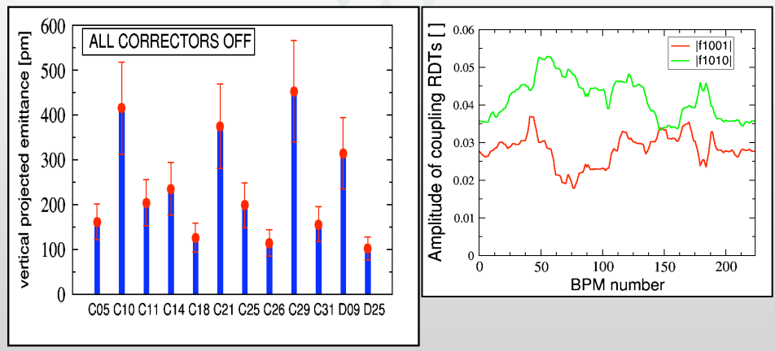
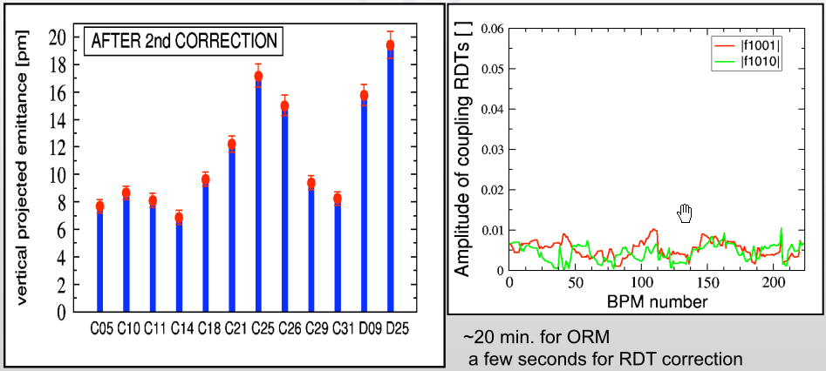
Resonant driving term coupling correction (A. Franchi)
A feedback system for coupling correction (via resonaces driving terms) is in operation at the ESRF

Slide 13
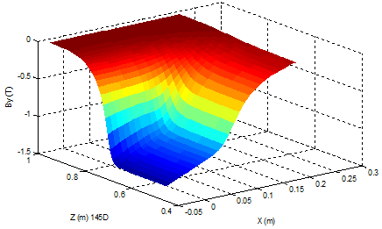
SPEAR3 model vs. measurement (X. Huang)
Improved model for SPEAR3 of gradient dipole and quadrupoles, including end field roll-off
Accurately predicted 0.1% stored beam energy error.
Improved agreement with measured tune shifts with amplitude.
Improved agreement in second order chromaticity.

Slide 14
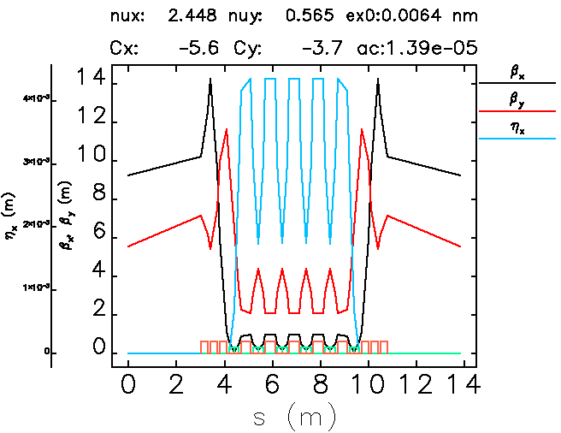
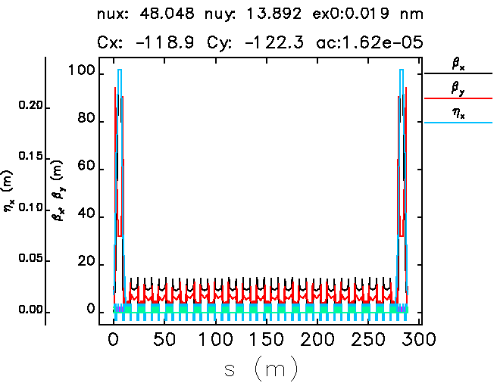
New ideas for low emittance lattice
A superconducting USR – 6T magnets
Minimize cell length to maximize N_{D}
Requires SC magnet strengths
High-η inserts for ξ correction
Work in progress
Circumference: 828m
Emittance: 6.4 pm
Number of straights: 60
straight length: 6m
Chromaticity: 336/ 222
Momentum spread: 7x10⁻⁴

Slide 15
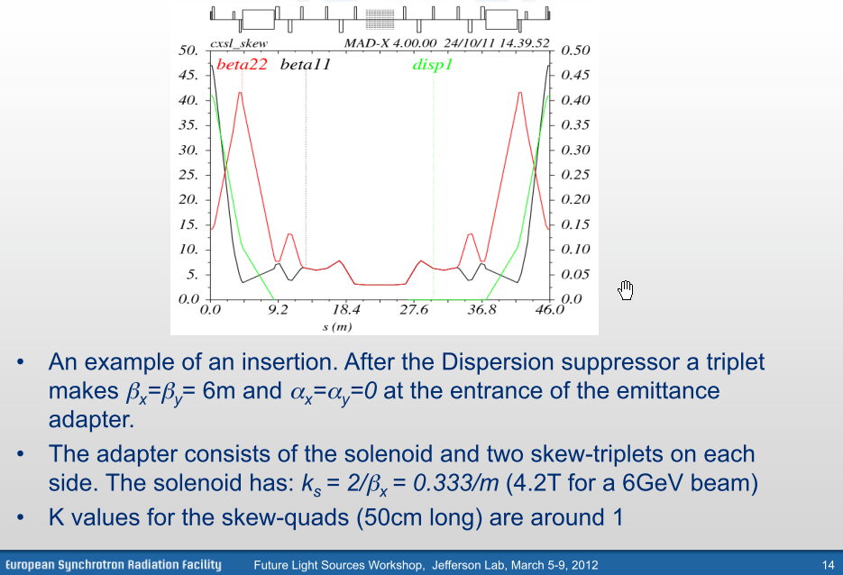
New ideas for low emittance lattice
Solenoid for local emittance exchange

Slide 16
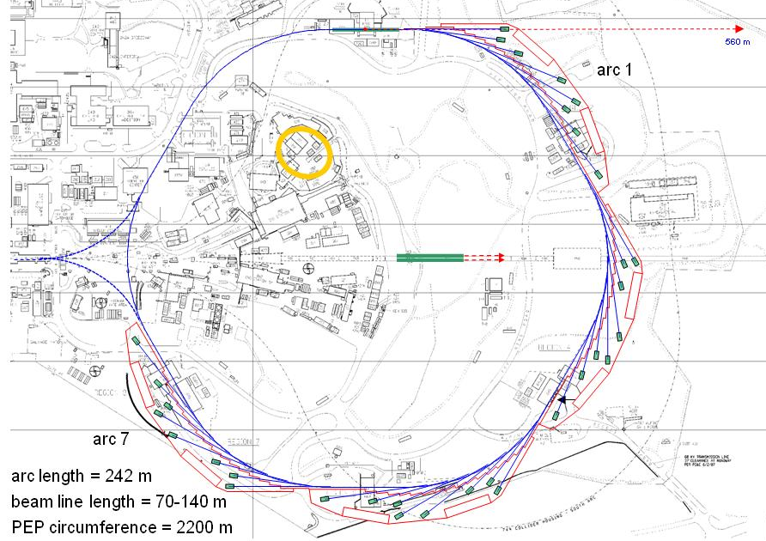
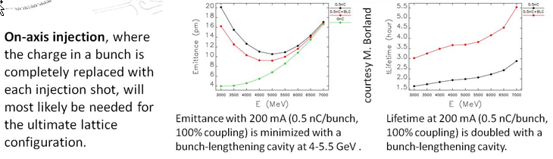
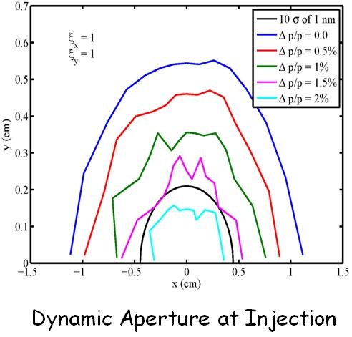
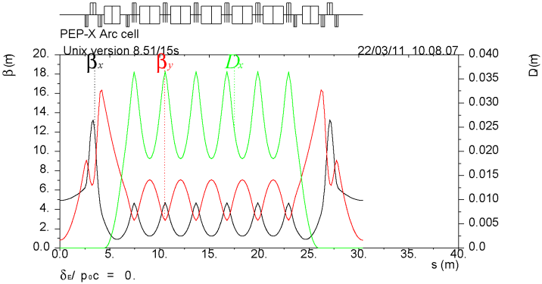
PEP-X: Diffraction-Limited Storage Ring at SLAC
Energy 4.5-5 GeV
Current 200 mA
Emittance (x/y) 11/11 pm
Bunch size (x/y, ID) 7.4/7.4 μm rms†
Bunch length 4 mm rms*
Lifetime >2 h*
Damping wigglers ~90 m
ID length (arc) ~4 m
ID length (straight) <100 m
Beta at ID center, (x/y) 4.92/0.8-5 m
Circumference 2199.32 m
Harmonic number 3492
† Vertical beam size can be reduced towards 1 μm
* Harmonic cavity system would increase bunch length to ~8 mm and double the lifetime
sufficient dynap for off-axis injection
R. Hettel, SLAC
7BA cell

Slide 17
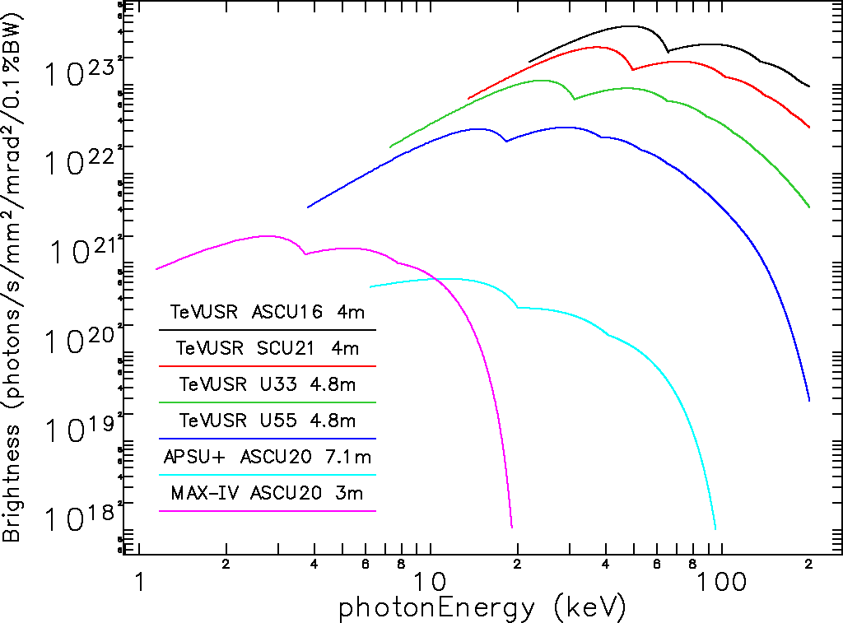
Tevatron-Sized Ultimate Storage Ring (M. Borland)
An 11-GeV MBA light source with 6.28km circumference is being explored
  Would run with 8300
  bunches, round beams,
  using on-axis
  “swap-out” injection
  Results with IBS
  are promising
  Nonlinear performance
  looking good for slightly
  relaxed lattice
Damping undulators (m) | Current (mA) | Bunch length (ps) | Energy spread (%) | Emittance (pm) | Touschek lifetime (h)
0 | 100 | 17 | 0.12 | 2.7 | ~2
188 | 100 | 10 | 0.14 | 1.3 | ~2
M. Borland, ANL

Slide 18
Analysis of Collective Effects for PEP-X (K. Bane)
In ultimate storage rings, such as the latest version of PEP-X, impedance effects tend not to be important since the current is quite low (200 mA)
IBS sets the limit of current that can be stored in an ultimate ring. In PEP-X with round beams, IBS doubles the emittance to 11 pm at the design current of 200 mA
The Touschek lifetime in ultimate PEP-X is quite large, 11 hrs, but it is a very sensitive function of the momentum acceptance
How to run a machine with a round beam needs serious study. E.g. using vertical dispersion may be preferable to coupling. The choice will affect the IBS and Touschek effect
In the higher current version of PEP-X (baseline, 2010, I =1.5 mA), the transverse single and multi-bunch instabilities can become an issue, with the small-gap insertion devices becoming dominant contributors to the (transverse) ring impedance
Notes:
Current limted by heat load

Slide 19
R&D for Diffraction Limited Rings (R. Hettel)
Identify scientific applications and their needs
Based on scientific needs, optimize lattice type, circumference, beam energy, emittance, energy spread, ...
  MBA seems a clear choice,
  Optimize dynamic aperture and lifetime
  Determine best approach for making round beams
Study collective effects (IBS, lifetime, instabilities)
Determine requirements for injection and injector
Investigate component designs with emphasis on cost control
Perform code development and benchmarking
Beam lines for using and preserving high brightness
Subjects are generally well understood in ring community
(DLSR Working Group, R. Hettel et al.)

Slide 20
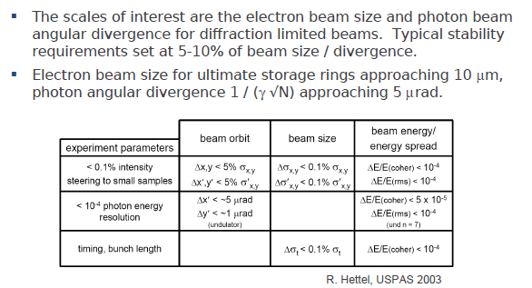
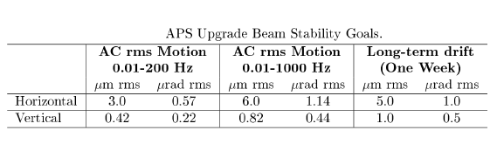
Storage ring technology
Diagnostics: Ebpm and Xbpm development (G. Decker)

Slide 21
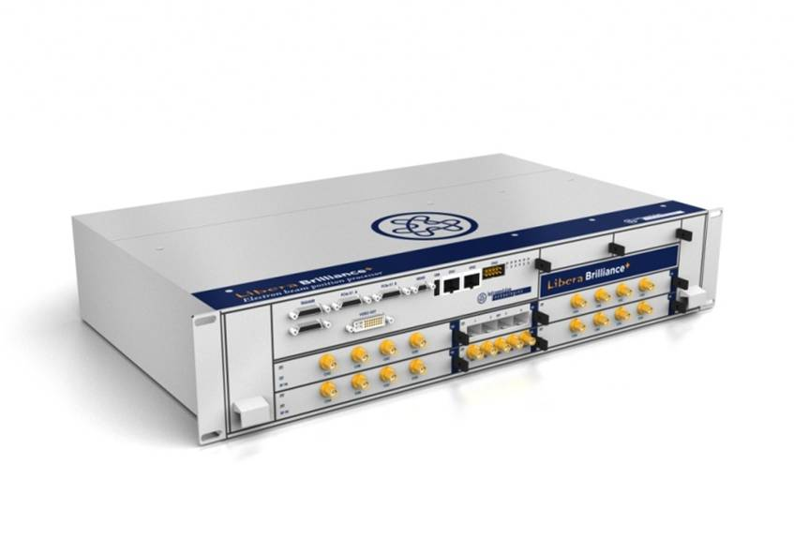
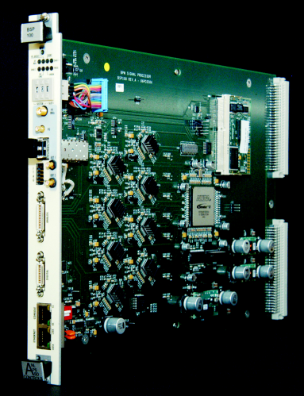
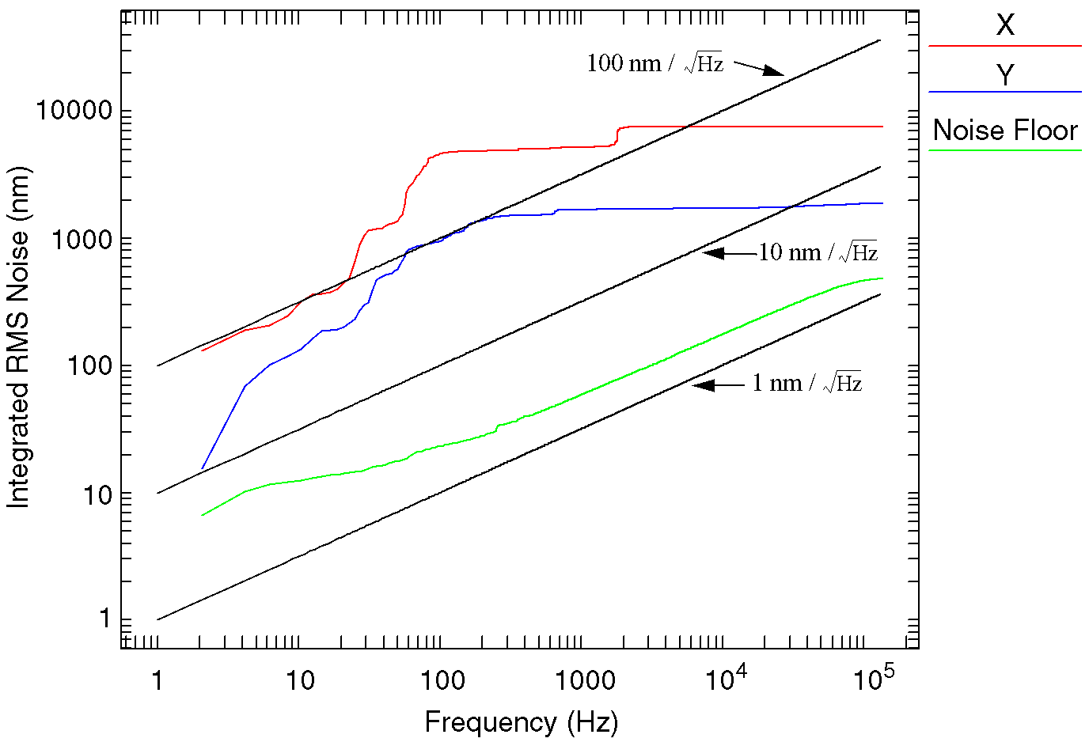
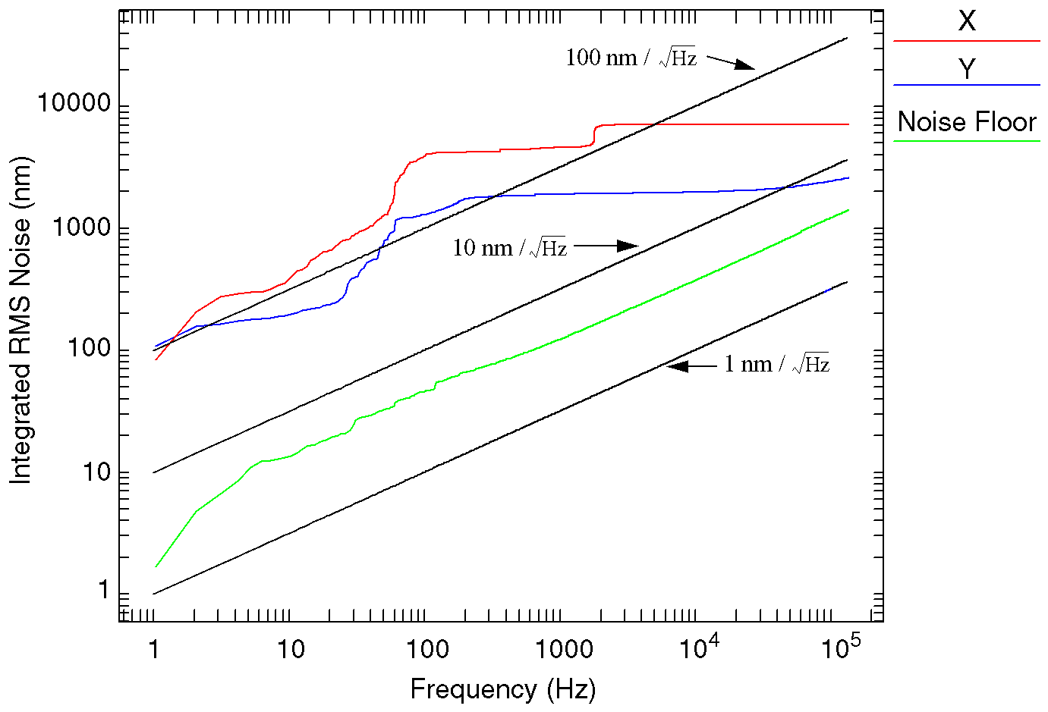
RF BPM Electronics - APS
Libera Brilliance@APS
APS BSP-100 Module
H. Bui etal., BIW08

Slide 22
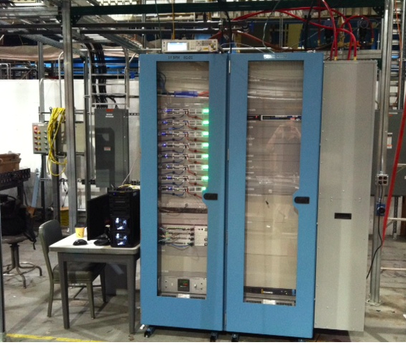
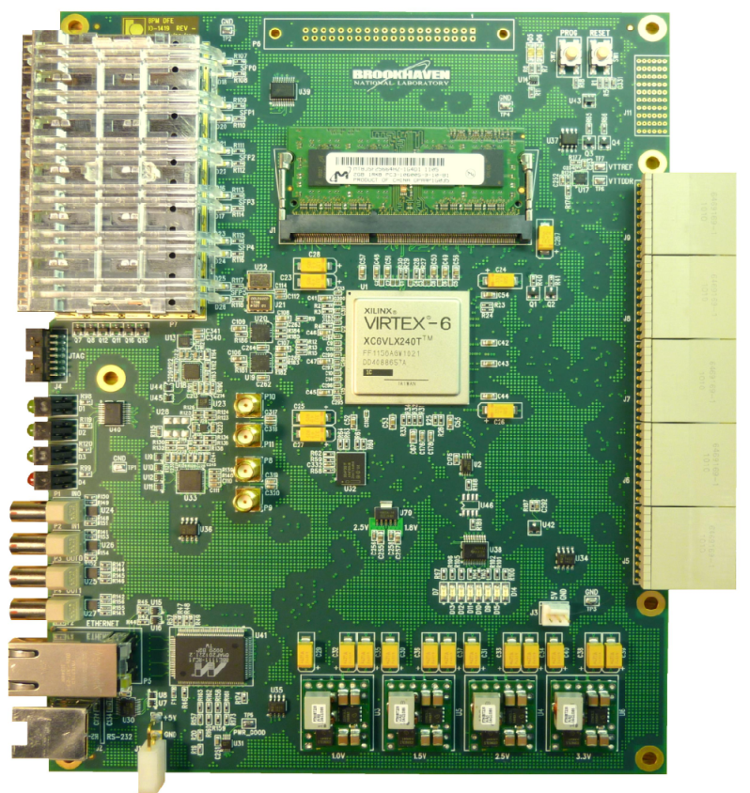
RF BPM Electronics – NSLS II
Thermal rack (+-0.1C) Storage Ring
NSLS II Digital Front End
Cell Controller
Long-Term Stability (200nm) based on thermal rack stability of +/- 0.1C
Off-frequency pilot tone used to further improve long-term drift.
Up to 8M samples (ADC data, TbT, FOFB)
Simultaneous EPICS and Matlab communication
K. Ha etal., ICALEPCS 2011

Slide 23
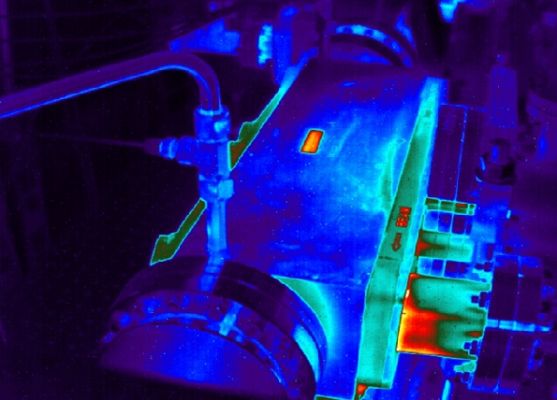
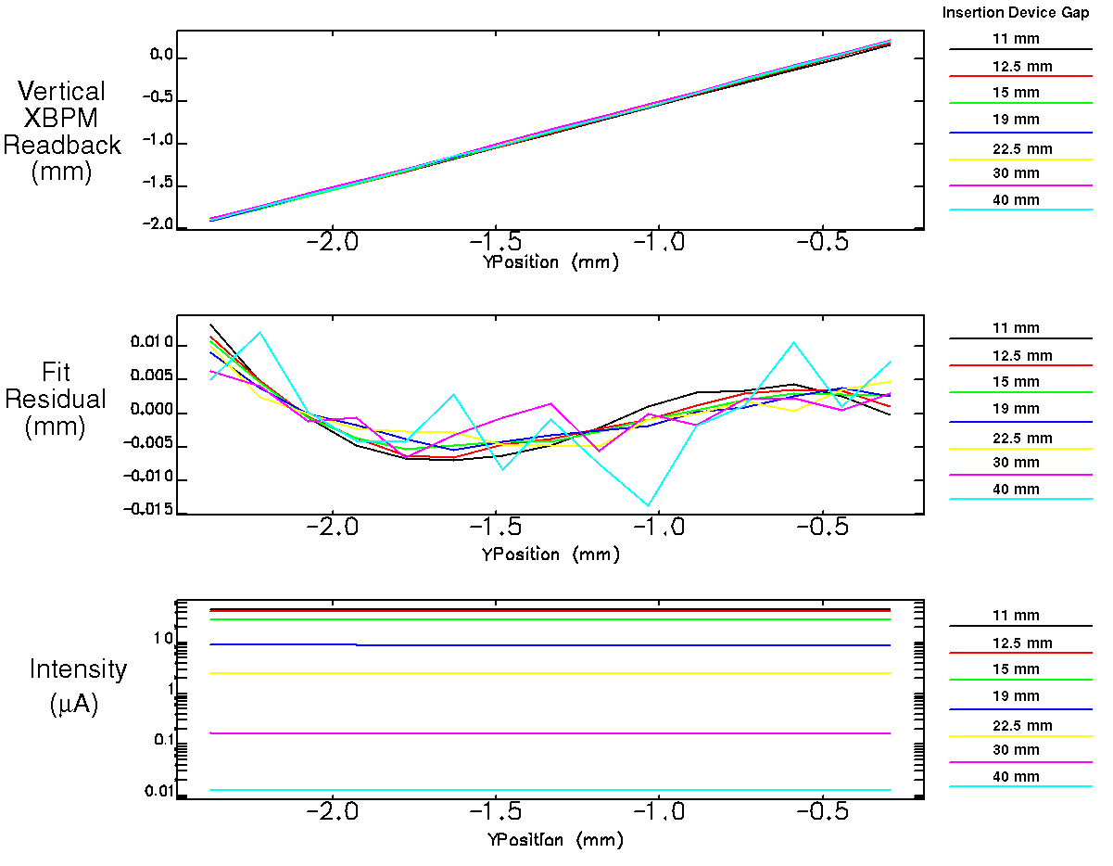
High-Power Photon BPMs
Based on X-ray Fluorescence at APS (G. Decker)
Linear XBPM Vertical Response for
Greater than 3 Decades of Signal Intensity
Extensive studies have taken place at the APS investigating copper x-ray fluorescence vs.
photoemission for photon beam position monitoring
IR camera image of copper GRID-XBPM
intercepting approx. 5 kW of x-rays from
two in-line undulator A sources with
102 mA of stored beam.
B.X. Yang etal., PAC11
Vertical Position
(at 27 meters from source)

Slide 24
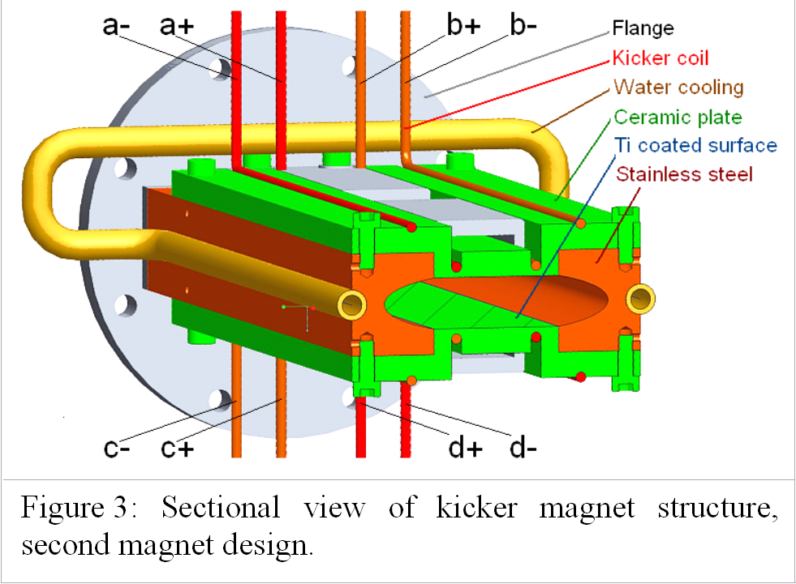
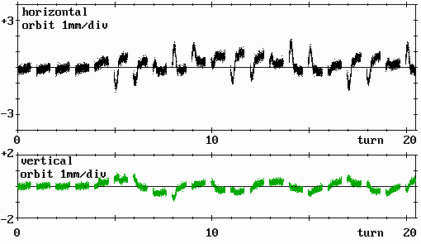
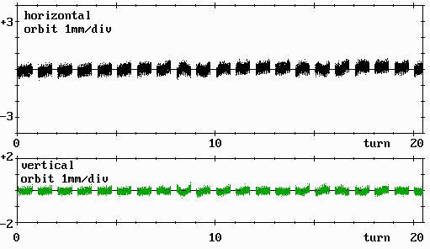
Pulsed Magnets for injection into small-dynamic-aperture machines
(Andreas Jankowiak, HZB-BESSY)
Single pulsed nonlinear kick element with zero field at stored beam location used to minimize impact of injection on stored beam during top-up operation:
Four-wire BESSY design*
Pulsed Quadrupole**
Injection efficiency up to 85 %
no excessive thermal heating
kick experienced by stored beam strongly reduced but still non zero

Slide 25
BESSY II and Superconducting Cavities
G. Wuestefeld, HZB BESSY II
sc-cavities for bunch shortening
bunch length – current relation
sc-cavities (scheme)
100x enhanced rf-gradient
cavity V₁,f₁
cavity V₂,f₂
~ 5 m
straight
->J. Feikes et al, EPAC 2006

Slide 26
G. Wuestefeld, HZB BESSY II
Simultaneously Long and Short Bunches
Simultaneously long & short bunches
present nc-cavity (power)
sc-cavity # 1 (focusing)
sc-cavity # 1 & 2 (focusing)
short
bunch
short & long bunches
long
bunch
Voltage / MV
sum voltage
rel. long. phase position / ns
0.5 GHz, 1.5 MV
V’=Vxf_{rf}= 0.75 MVGHz
1.5 GHz, 25 MV
V’=Vxf_{rf}= 37.5 MVGHz
1.75 GHz, 21.4 MV
V’ = Vxf_{rf}= 75 MVGHz
Future goal is to operate
flexible fill pattern, I<300 mA
15 ps & 1.5 ps pulses simultaneous at all beam ports
THZ poer increase x10000
all IDs available

Slide 27
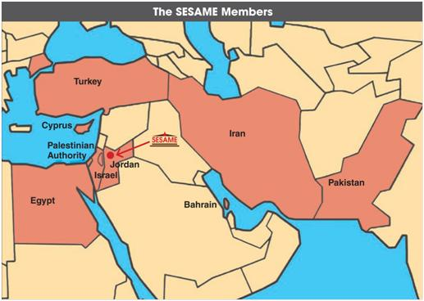
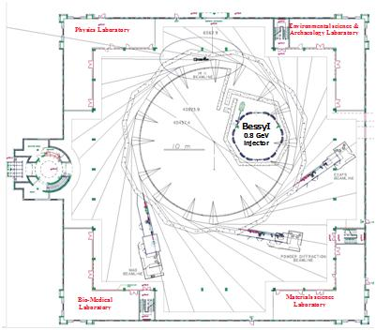
SESAME – A Light Source for the Middle East
Herman Winick, SLAC
C= 133 m E = 2.5 GeV ε_{x} = 26 nm
10 beam lines specified for phase 1
Under UNESCO auspices, patterned after CERN
Members: Bahrain, Cyprus, Egypt, Israel, Iran, Jordan, Pakistan, Palestine, Turkey, Iraq pending
45 Nobel laureates have endorsed SESAME
Accelerator group from Palestine, Jordan, Iran…
Uses BESSY-I microtron and 800 MeV booster
Many component donations from international labs
Training program for young scientists, including sending them to international labs
International funding for travel to conferences, schools, etc.
Looking for funding to finish construction
WG noted that the 28-nm emittance might be reduced using Robinson wigglers

Slide 28
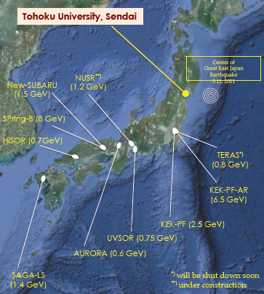
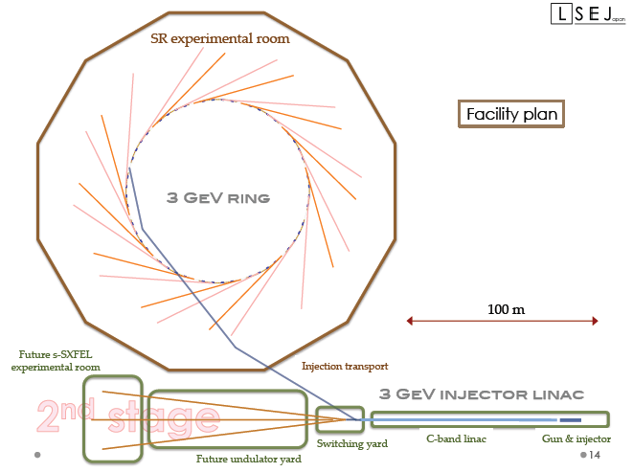
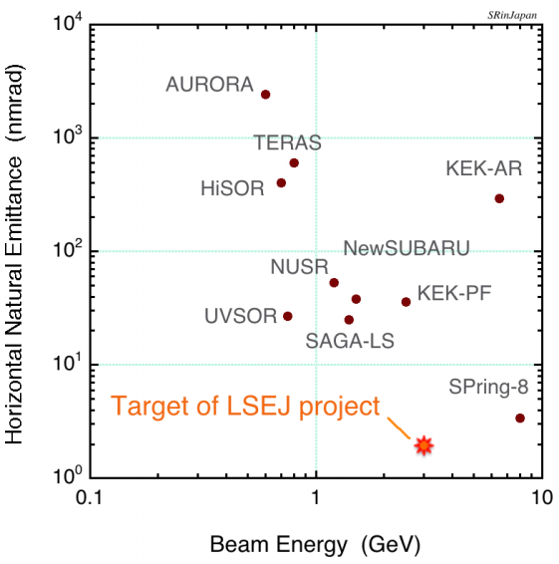
  Light Source in East Japan – Hiroyuki Hama, Tohuku University
Need another mid-E high brightness source in Japan
Project would stimulate investment and economy in NE Japan
Supported by 7 national universities
3-GeV C-band linac injector (could be soft-XFEL driver)
Want simple lattice – want construction and commissioning to be quick
12-cell, 4BA as baseline (are 10 IDs OK?)
Alba is closest design – 4 nm, 16 cells
Needs at least 250 M$-- will abandon proposal if funding not approved in 2 years (before KEK ERL, SPring-8 funding)
C= 289 m
E = 3 GeV
ε_{x} = 2 nm
B ~ 10²¹

Slide 29
Comparison ERL/USR (C. Steier)
Performance Metric | Advantage | Reason / Comment
Average Brightness | Similar | 25 m undulators in ERL, 4-8 m in USR
Average Flux | USR | ERL would require currents >> 100 mA
Transverse Coherence | ERL? | ERL might have matching advantage
Stability | USR | ERL has additional jitter sources
Reliability | USR | Cryoplant, Multiple RF systems for ERL
Short Pulses | ERL | But seeded FELs supplant both – reasonable add-on for USR possible
Useful repetition rate | USR? | ERLs need higher rep rate for high brightness
Photon Energy Tunability | Similar | USRs can have similar ID apertures
Tailored lattice functions | ERL? | MOGA methods allow non-symmetric ring designs
Effects of Undulators on other users | USR? | Long IDs in ERL produce substantial energy loss for downstream beamlines
Cost / Beamline | USR | Number of beamlines, cryoplant, …
Operating Cost | USR | Large Cryoplant, Power consumption for ERL
Maturity of Design | USR | Technical components are ready
Risk | USR
Overall USRs appear to have (slight) advantage and seem to complement FELs better

Slide 30
ERL/USR Comparison (I. Bazarov)
TODAY: Cornell ERL photoinjector project has already achieved beam brightness that at 5 GeV would be equivalent to 100mA 0.5nm-rad × 0.005nm-rad storage ring Gaussian beam
TOMORROW: both technologies (SR and ERL) can reach diffraction limited emittances at 100mA
SR can easily do several 100’s mA (x-ray optics heat load??), ERLs not likely
ERL is better suited for very long undulators (small energy spread) and Free-Electron-Laser upgrades (using its CW linac)
Both technologies can deliver super-bright x-rays with a CW SRF linac of ERL having an edge for FEL techniques

Slide 31
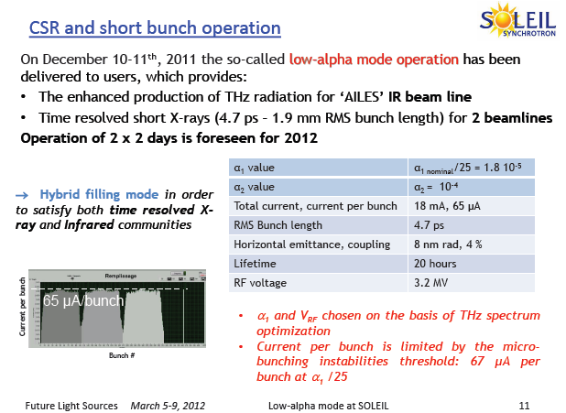
Low alpha lattice and THz emission – SOLEIL (A. Loulergue)
Low alpha lattice improved by switching one family of quadrupoles and sextupoles polarity

Slide 32
Low alpha lattice and THz emission – MLS (G. Wuestefeld)
The MLS is the first storage ring optimized for CSR
successful control of 3 orders of α, no beam loss at the α₀ = 0 crossing
control of higher order terms of
α = α₀ + α₁δ + α₂δ²
α = α(Δp/p₀)
MAD-8 simulation
f_{s}= f_{s}(Δf_{rf})
MLS measurements
3
1
mom. comp. factor / 10⁻⁴
2 4 6 8 10 12 14 16 18 20
2
3
synch.-frequency f_{s} / kHz
2 4 6 8 10 12 14 16 18 20
octupole on
2
f_{s} = 9.5 kHz
α₀ = 4.6x10⁻⁴
octupole off
-2 -1 0 1 2
-4 -2 0 2 4
rel. momentum deviation / %
rf-frequency change Δf_{rf} / kHz
-> : slope of α = α(δ) -> α₁=0 , adjusted by sextupoles
1
2
2
-> : curvature of α = α(δ) -> α₂, adjusted by octupoles
3

Slide 33
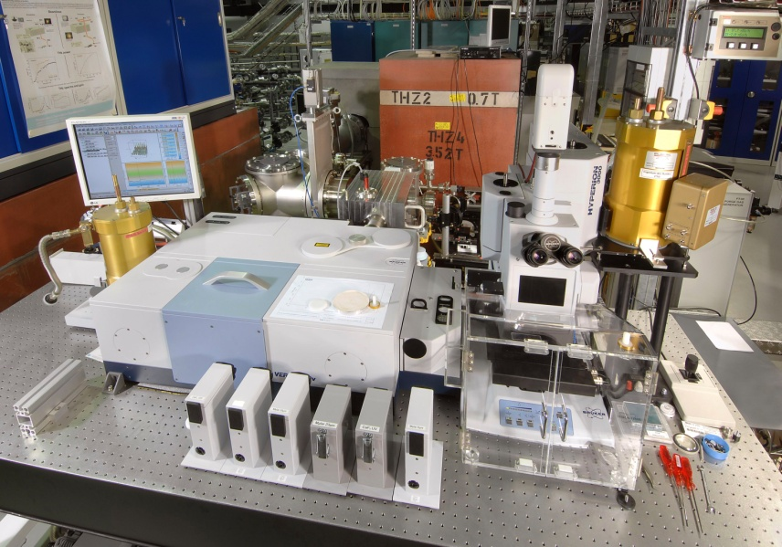
Low alpha lattice and THz emission – MLS (G. Wuestefeld)
THz beam port at the MLS
CSR power spectrum
beam line
corrected
gain = 100,000
THz detector
FTIR spectrometer
IR microscope
Example of hardware setup at the THz beam port.
Different types of detectors are available.
Experiments: detector characterization and
development (partly in cooperation with DLR (Berlin)
and KIT (Karlsruhe)) and spectroscopy.
Spectral range 1.4 1/cm (not shown in fig.) to 50 1/cm.
incoherent signal mixed with coherent signals, corrected gain = 100,000
stable and bursting THz-CSR can be produced
bursting thresholds agree fairly well with theory

Slide 34
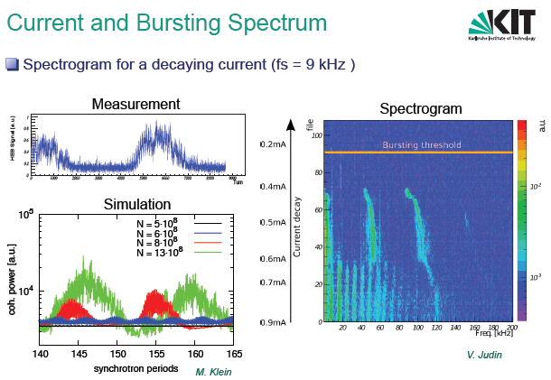
Low alpha lattice and THZ emission at ANKA (M. Schuh)
Ongoing projects to study bursting dynamics, bunch deformations, and
micro bunching with novel high resolution detector systems

Slide 35
Acknowledgments
Bob Hettel co-convener
Chair of sessions
J. Safranek
M. Borland
X. Huang
Speakers
L. Yang, J. Bengtsson, W. Guo, A. Franchi, M. Sjostroem, C. Steier, I. Bazarov, K. Bane, H. Winick, H. Hama, S. Casalbuoni , A. Temnykh, A. Xiao, O. Chubar, M.E. Couprie, G. Decker, A. Jankowiak, G. Wuestefeld, A. Loulergue. M. Schuh.

